Slide 1
Instructions
Important between 1- and 5-point deduction if NOT followed.
✓ Follow the sequence in the rubric, Part 1 and 2
✓ Make sure you use MINIMUM font size 11 for the body text.
✓ Use a white background and black font, do NOT use a dark-colored background-that it is not easy to read when printed.
✓ Make sure you have nicely cropped screenshots with callouts explaining any suggestions-make sure images are not fuzzy.
✓ Make sure all your slides are numbered and that you also have your group number on each slide.
✓ Save the ppt as a PDF and compress if too big for uploading https://smallpdf.com/compress-pdf then upload to elearning-ONLY one document, please. Make sure it is not fuzzy after being compressed

Slide 2
Client Profile
Terry Costa, Dallas, TX 75230
65 employees
Prom dresses, mother-of-the-bride dresses, homecoming dresses, bridal dresses, event attire
Founded in 1986
https://www.terrycosta.com/
Website age: 23+ years
Social Media:
https://www.linkedin.com/company/terry-costa/
https://www.facebook.com/terrycostaprom/
https://twitter.com/terrycostabride
https://www.instagram.com/terrycostaprom/
https://www.youtube.com/c/terrycosta
https://www.tiktok.com/@terrycostaprom
https://www.pinterest.com/terrycosta/_created/
In-store sales, online sales, Terry Costa mobile truck
Direct sales for Terry Costa Exclusives and resell for prominent retailers: Sherri Hill, Allure, Maggie Sottero, Rebecca Ingram, Wilderly, Faviana, Morilee, Madison James, Primavera Couture, Ellie Wilde, Colors, Alyce, Dave and Johnny, and more

Slide 3
Market Analysis
Profile of current customers – Brides, High School Students, Mothers of the Brides
Any customer journey/surveys? Terry Costa is a staple for prom and wedding dresses in Dallas and word of mouth has been a great tool for business, they utilize EventBrite for different events in-store (trunk shows, fashion shows, etc), Google.
Top competitors:
https://www.promgirl.com/
https://www.whatpromdress.com/
https://sherrihill.com/
https://peachesboutique.com/
https://henris.com/
https://www.lulusbridal.com/
Overview of the industry: The Prom, event, and bridal industry has been steadily increasing for decades. However, purchases are split among different socioeconomic groups. Different regions across the country have different aesthetics and price points so sales on a national scale vary.
Market position/specialties: Using their keyword rankings, Terry Costa has a share of voice of about 30 percent compared to top competitors in this space.
Unique selling points of the goods/services offered –low cost? Differentiation-real or perceived and/or niche/segmentation: Terry Costa sells designs from popular designers across the event, bridal, and prom markets. They update their designs every season. There’s no guarantee that you can get a particular design at a boutique shop.
Price point vs direct competitors: Standard.
Seasonality of their goods/services or seasonality that the company has identified: Homecoming Season, Prom Season, Wedding Season
Average order size and Gross margin- 1 dress per event. The average order size in the past year was around $400, but it varies among product types. Assume a gross margin of 55% and profit margin of 15%.
No LTV has been calculated.

Slide 4
Current Marketing
Website uses, e.g., sales, customer service, leads: Sales, Customer Service, Product Inquiry
Website strengths and weaknesses: Strength in SEO, but poor website design compared to other competitors.
Mobile strategy or efforts? Optimize for e-commerce.
If any analytics reports from top social media platforms of interest-engagement, shares, etc.
Other online advertising and offline promotions such as TV, radio, direct mail, etc.- if any please provide sample collateral: none
NOTE for students: You have to understand your product category and target audience. Do some quick market research, e.g., https://trends.google.com/ to find maybe popular dresses within your category this year or season, seasonality, media habits, etc.

Slide 5
Terry Costa Bridal Dresses
MKT 6321.0W1 - Group 01
Nathan Henochowicz
Rahul Kotian
Madeline Lopez Burgos
Jordan Patt
Katie Schwenke

Slide 6
Part 1 - Find social media campaign ideas through research/benchmarking (approximately 3-4 slides)
Decide if you will focus on high school girls (prom/homecoming) or brides.
Focus on only 3 platforms: TikTok, Instagram, and on either Facebook, YouTube or Pinterest.
Review and analyze Terry Costa’s social media vs competitors that have a better social media than what Terry Costa has. When you find something provide relevant metrics so an indication it was successful (e.g., 800 shares)
The main objective is to find ideas of successful social media campaigns (influencers, competitions, etc) – do NOT show me slides of Terry Costa’s site or social media platforms and critique them -you only have a few slides! Make sure the ideas have good engagement metrics.
Show a minimum of two screenshots per slide and indicate the content/competition ideas you are suggesting be replicated/modified--they must be substantial
HINT: if their competitors are not very good, look for a women’s fashion company that might have a more successful social media presence/engagement

Slide 7
Social Media Research
TikTok, Instagram, Pinterest
Group 01 – Part 1

Slide 8
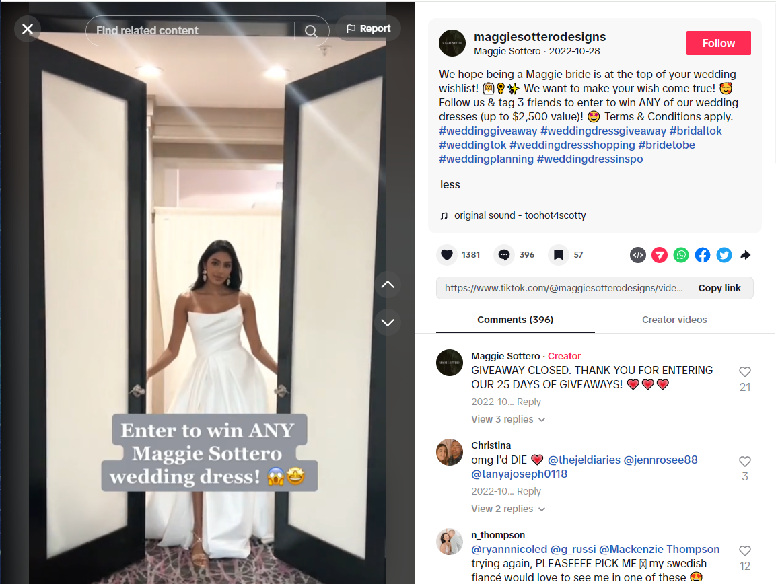
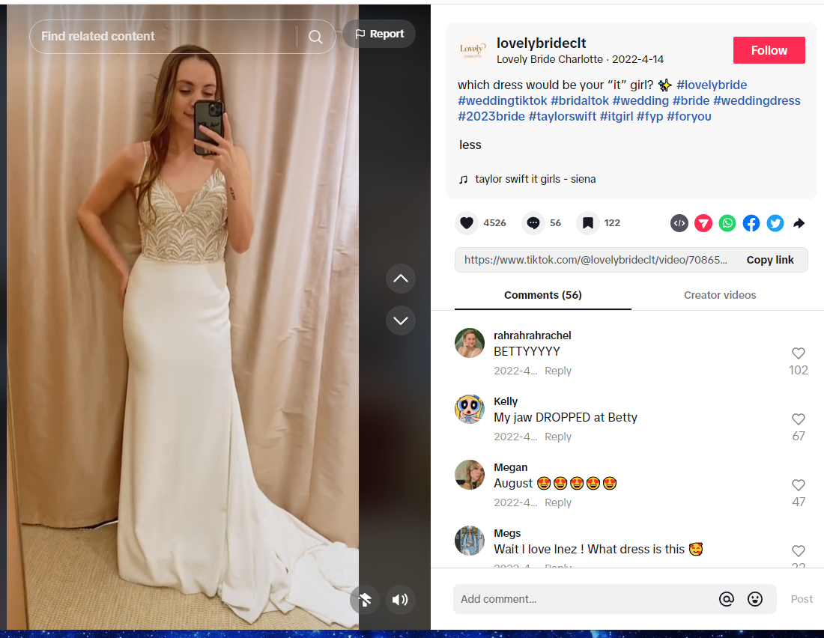
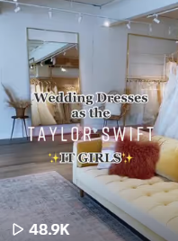
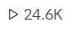
TikTok
Trending hashtags drive up viewership
Uses popular audio and celebrity references to increase viewership
Group 01 – Part 1

Slide 9
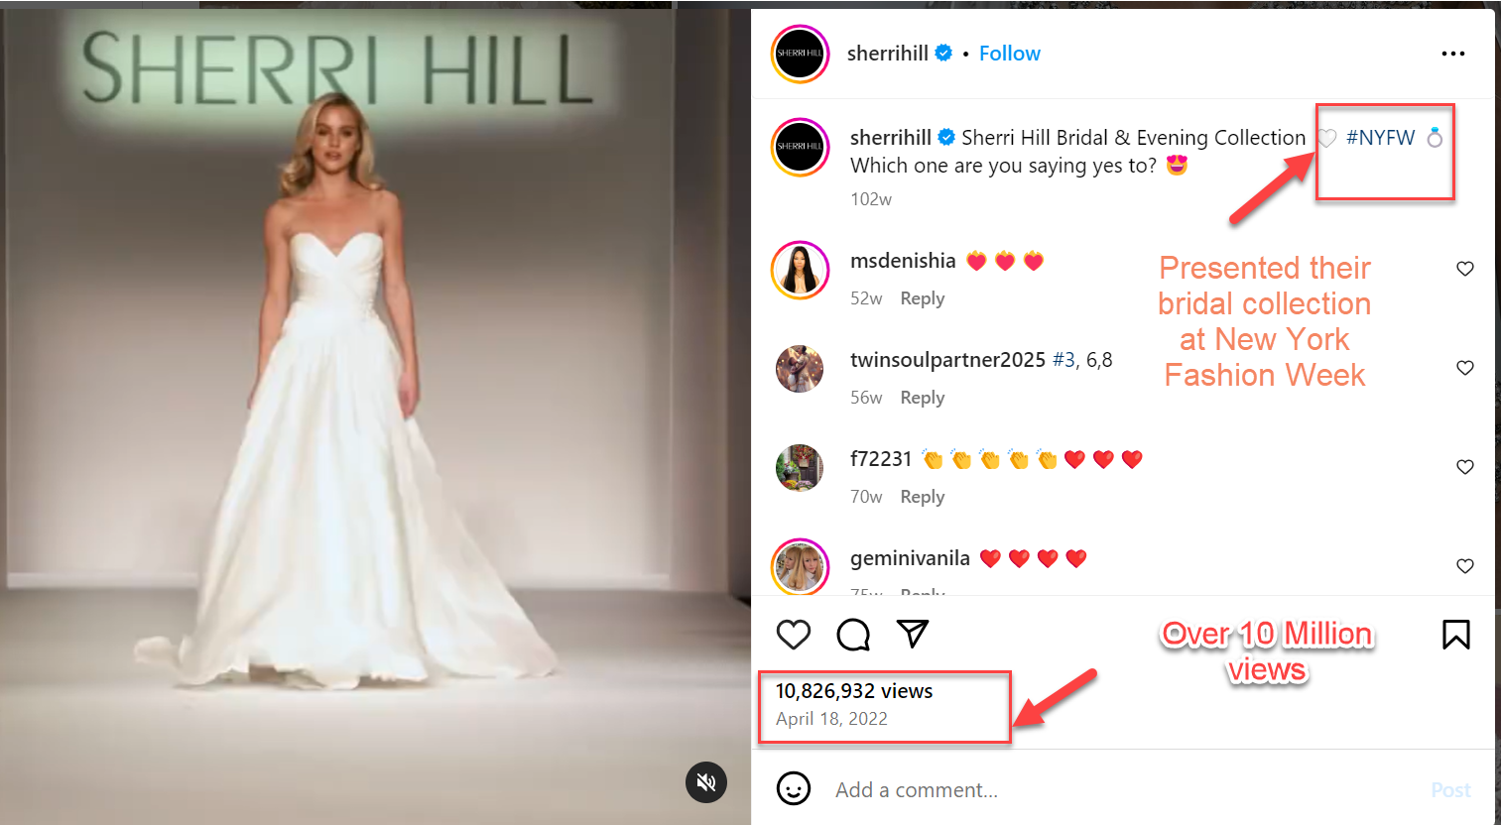
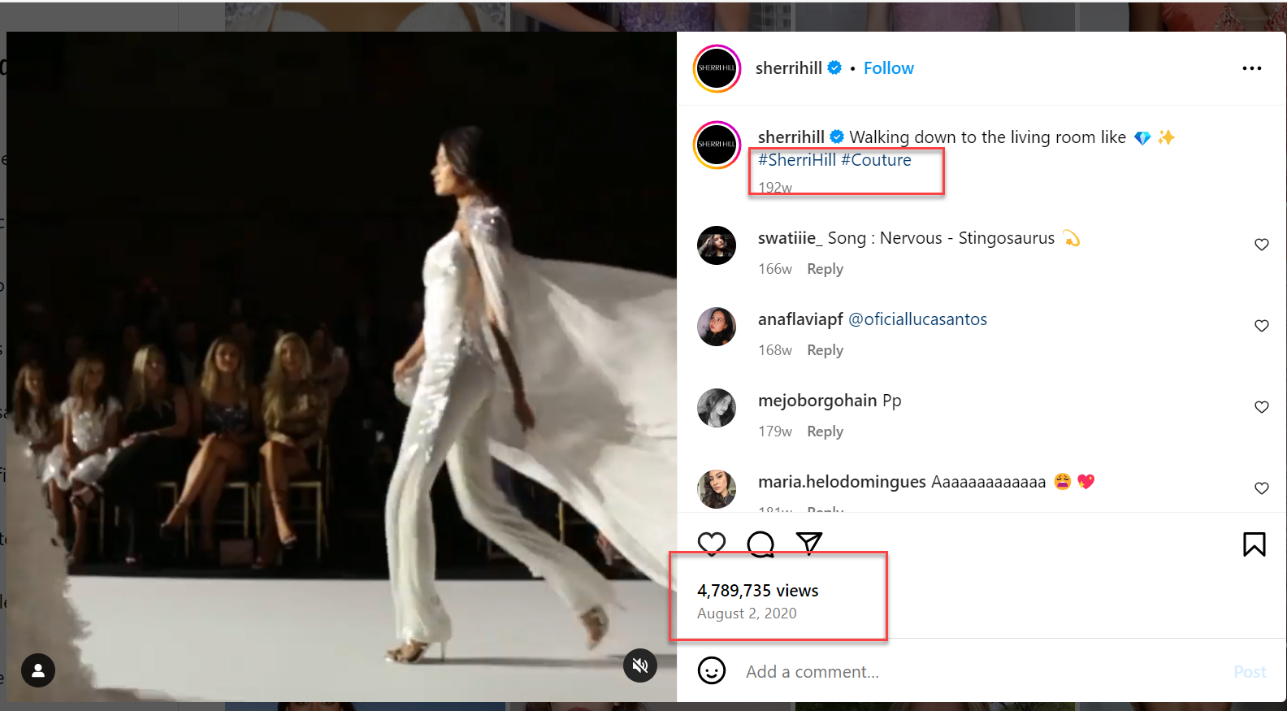
Instagram
Group 01 – Part 1
Notes:
https://www.instagram.com/tv/Ccf8ktLp4zB/?utm_source=ig_web_copy_link&igsh=MzRlODBiNWFlZA==

Slide 10
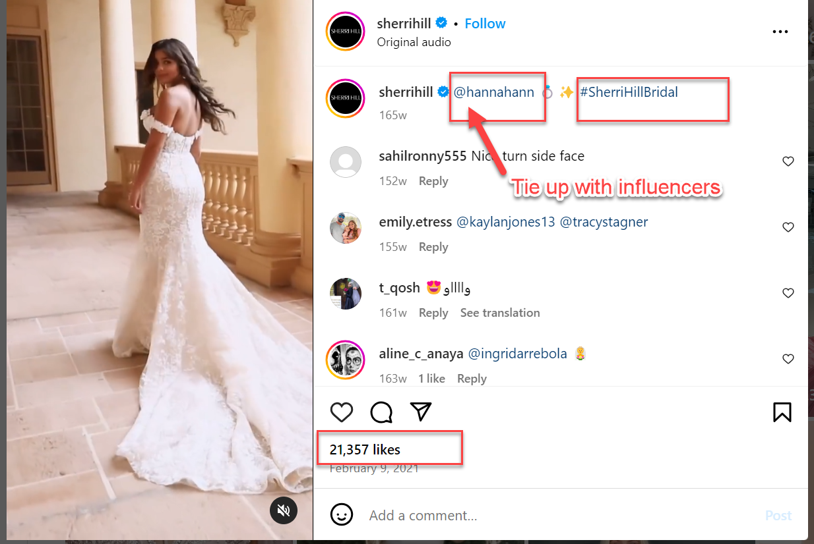
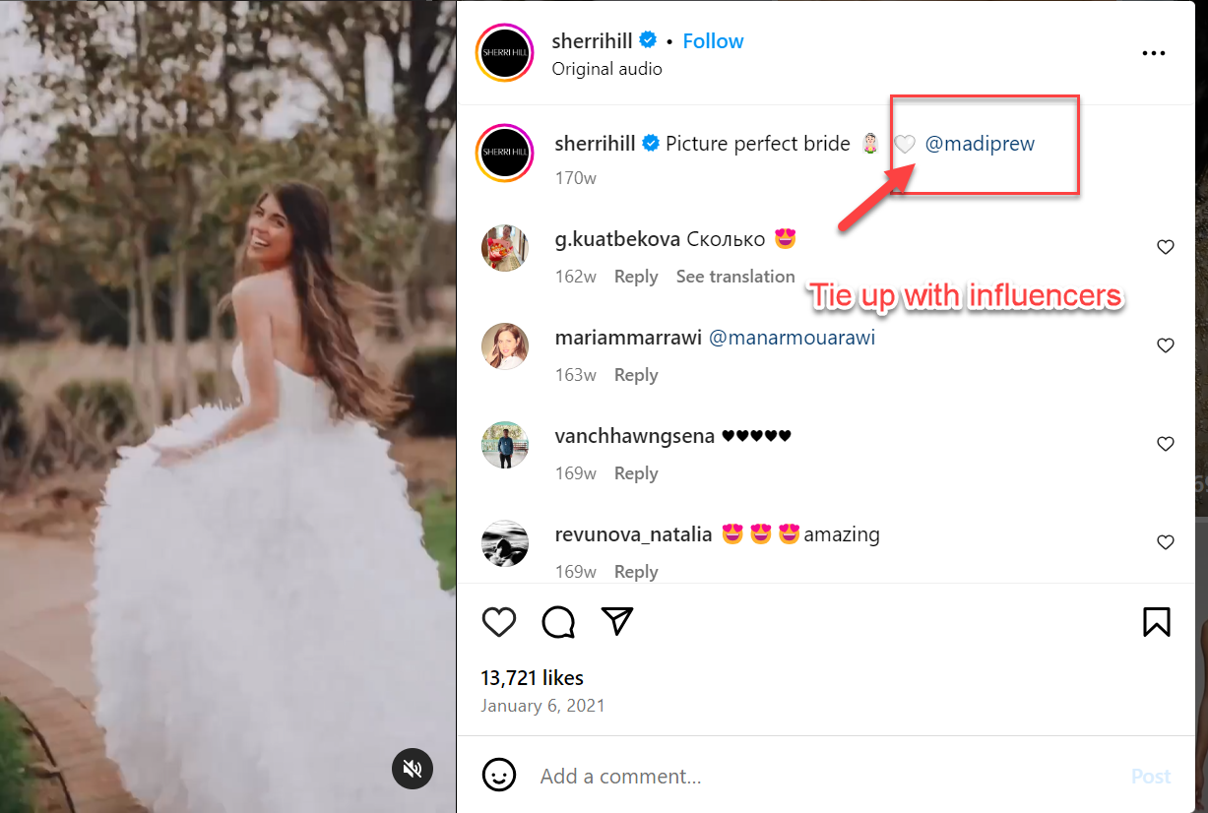
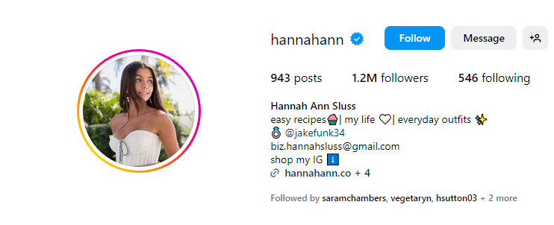
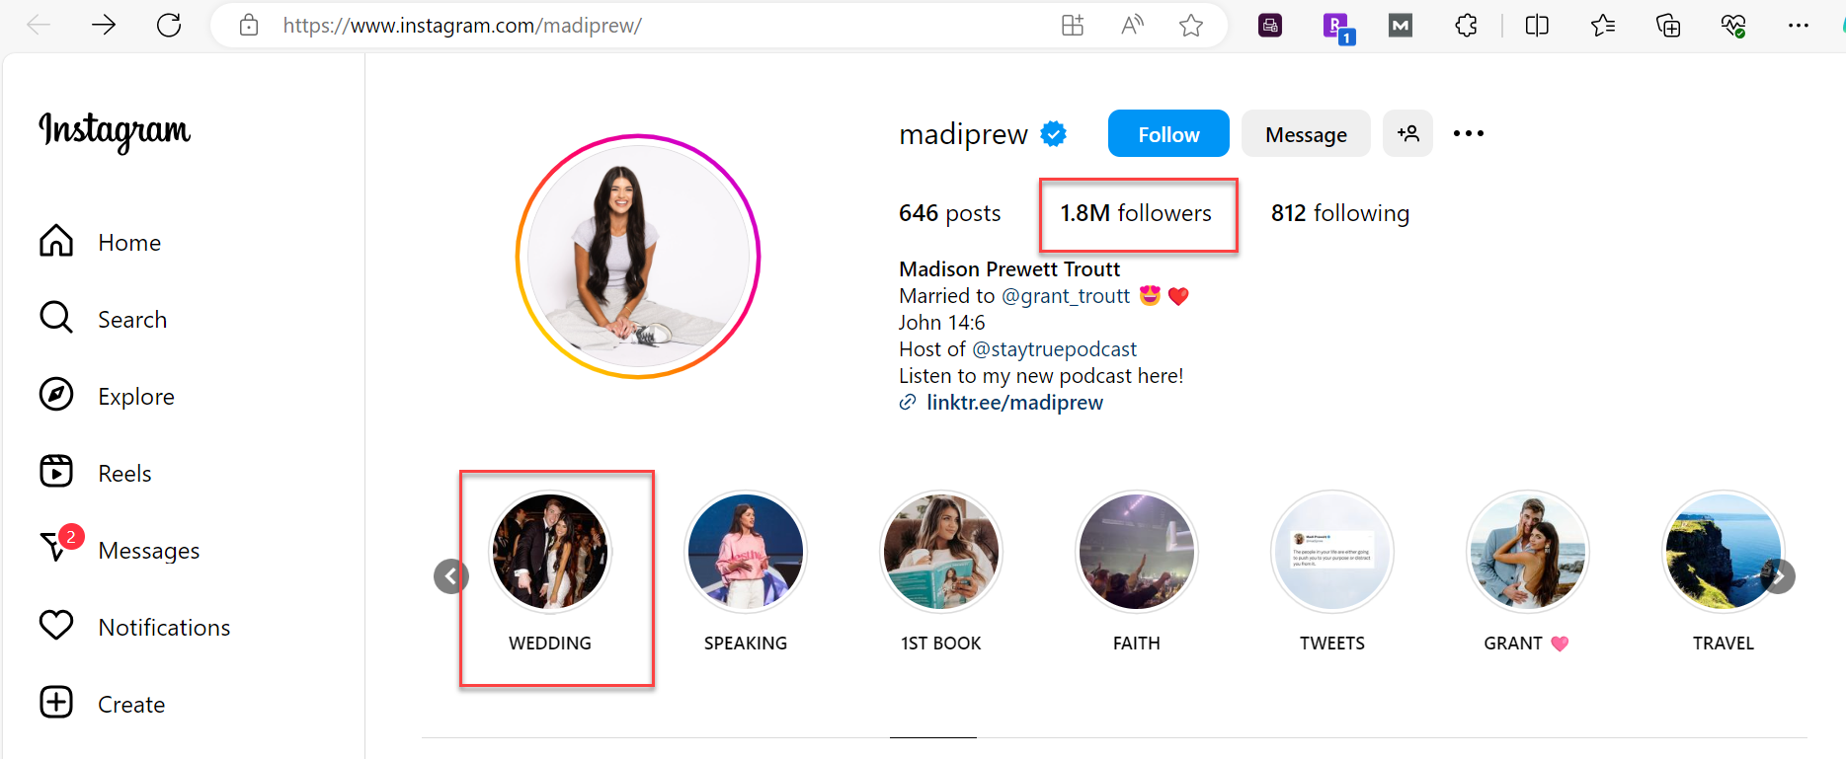
Instagram
Group 01 – Part 1

Slide 11
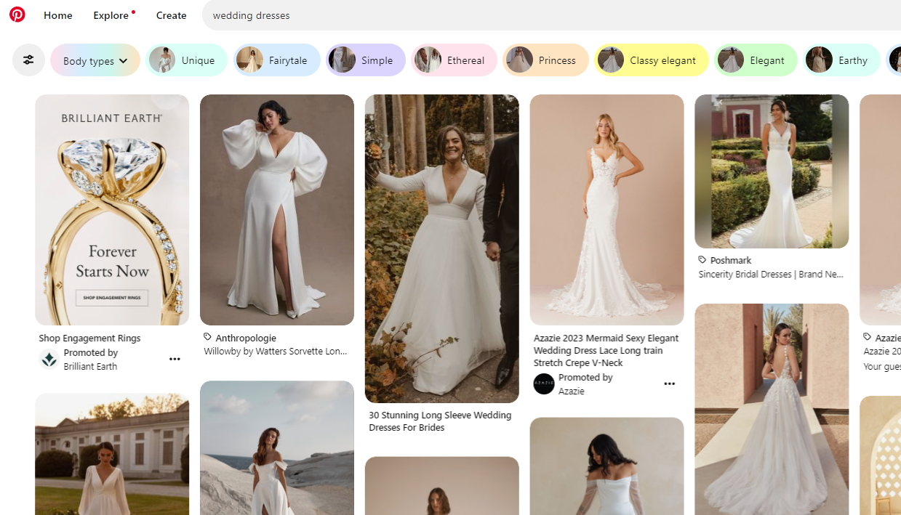
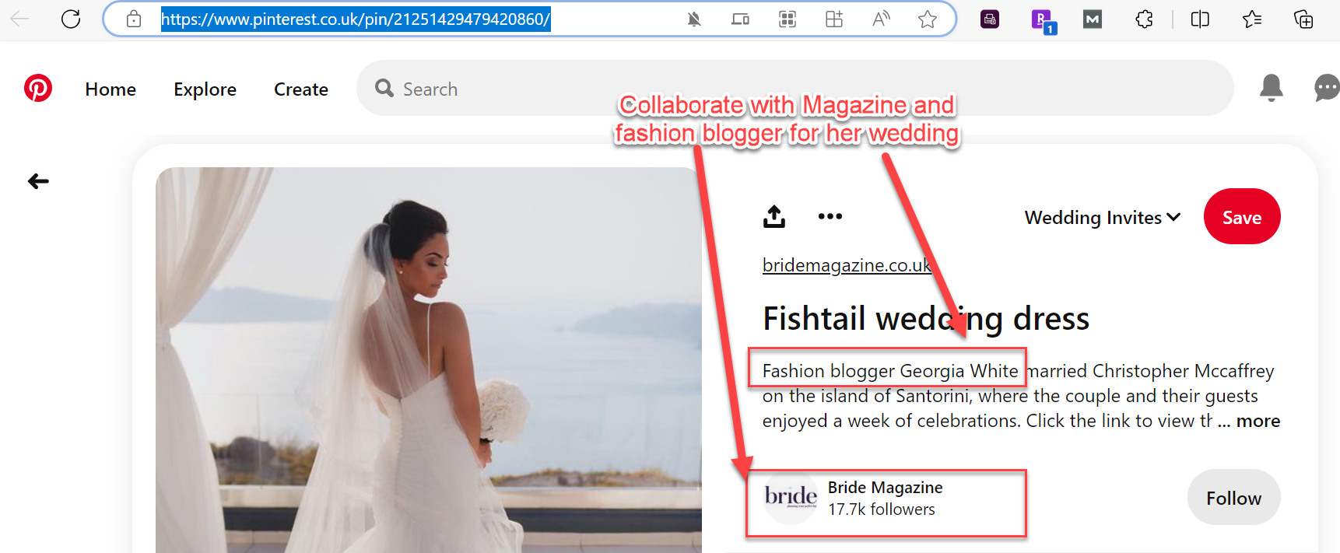
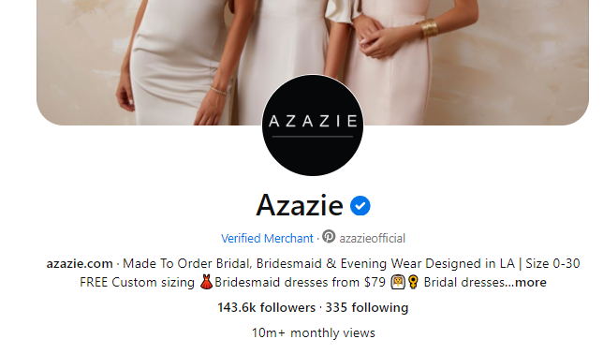
Pinterest
Paid promotional posts show above the fold in the first several pins driving up follower count and views
Group 01 – Part 1

Slide 12
Part 2 -Influencer campaign (approx. 7-8 slides)
Leverage and enhance the ideas found in the previous section. For this campaign, focus mainly on one platform and then describe how you would leverage the video on the other 2 platforms you will use.
Provide some demographic/behavioral/media habit information about your target audience; also provide information, within your category, of which dresses color/styles will be your main focus for this campaign- try not to pick more than 2 items to highlight (1 slide)
Identify an influencer for the bridal or high school dress category. Provide details and factors used when picking that influencer, show their reach and other metrics that made you pick them. Use the free tools suggested or find your own (1-2 slides)
Propose a lead generation campaign using a short video idea with the influencer as the centerpiece-(5-6 slides). You will NOT be shooting a video.
Must pick a relevant start and end date.
Provide a storyboard (visuals with text to show the USP and storyline of the ad/campaign message) which the influencer will execute (see example below) using images (no drawings). Next to the image, have a caption describing what is happening. Use a minimum of 6 tiles. Have a good call to action!
Show how you will amplify the video on the other 2 platforms and where you would sell the product (website directly, Instagram, etc). There is no need to create a real or detailed landing page- can just edit an existing page by copying and pasting, cropping., see the example below.
Specify how you will measure your ROI, define success metrics; for the purpose of this exercise, we will not consider the cost of paying the influencer, any production costs or coupon offers (e.g. 10% off). For the ROI only use the $10K cost (that would not be an acceptable method in the real world). The $10K is to be used to make the campaign “pop” e.g., incentive/prize. Anything else you can think of to encourage future business?
I will be evaluating the following:
Is this a lecture rehash of what are best practices, or have you done the analysis and recommended something unique, creative, and relevant? ARE YOU USING CONCEPTS IN THE LECTURES.
Must be conversion-focused not awareness/interest. Does it have a way to measure it?

Slide 13
Influencer Campaign
Target Audience, Influencer Campaign, Metrics
Group 01 – Part 2

Slide 14
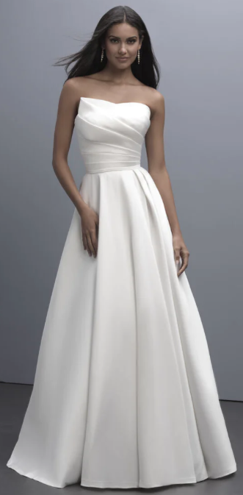
Demographics
Age: Women aged 20 to 40, primarily consumers in their late 20s to early 30s.
Income Level: Middle to upper-middle-income brackets.
Education: Tend to have a high school education, with most target consumers having pursued a higher education.
Relationship Status: Primarily engaged or soon-to-be-engaged individuals, with a small percentage purchasing for vow renewals.
Geographic Location: Urban and suburban areas contain majority of target customers.
Behavioral Patterns
Wedding Planning: Extensive time spent on research, decision-making, and purchasing.
Emotional Investment: Highly emotional experience, often involving friends and family members in decision-making.
Budget Considerations: Shoppers are budget-conscious when choosing a dress.
In-store Visits: Brides have option of trying on dresses in physical stores.
Media Habits
Social Media: Focus is on the best platforms for the young bride-to-be demographic; these include Instagram, Pinterest, and TikTok
Wedding Forums: Websites dedicated to wedding planning, print magazines, online blogs specializing in wedding content, and shows with a devoted following are popular forums.
Campaign Focus
The campaign will focus on the best platforms for the bridal dress demographic being Instagram
Long, sleeveless dresses will be white with minimal to no patterns
The contemporary style has been at the forefront of popularity amongst bridal dresses, with no sight of slowing down.
Cathe best platforms for your demographic
Group 01 – Part 2

Slide 15
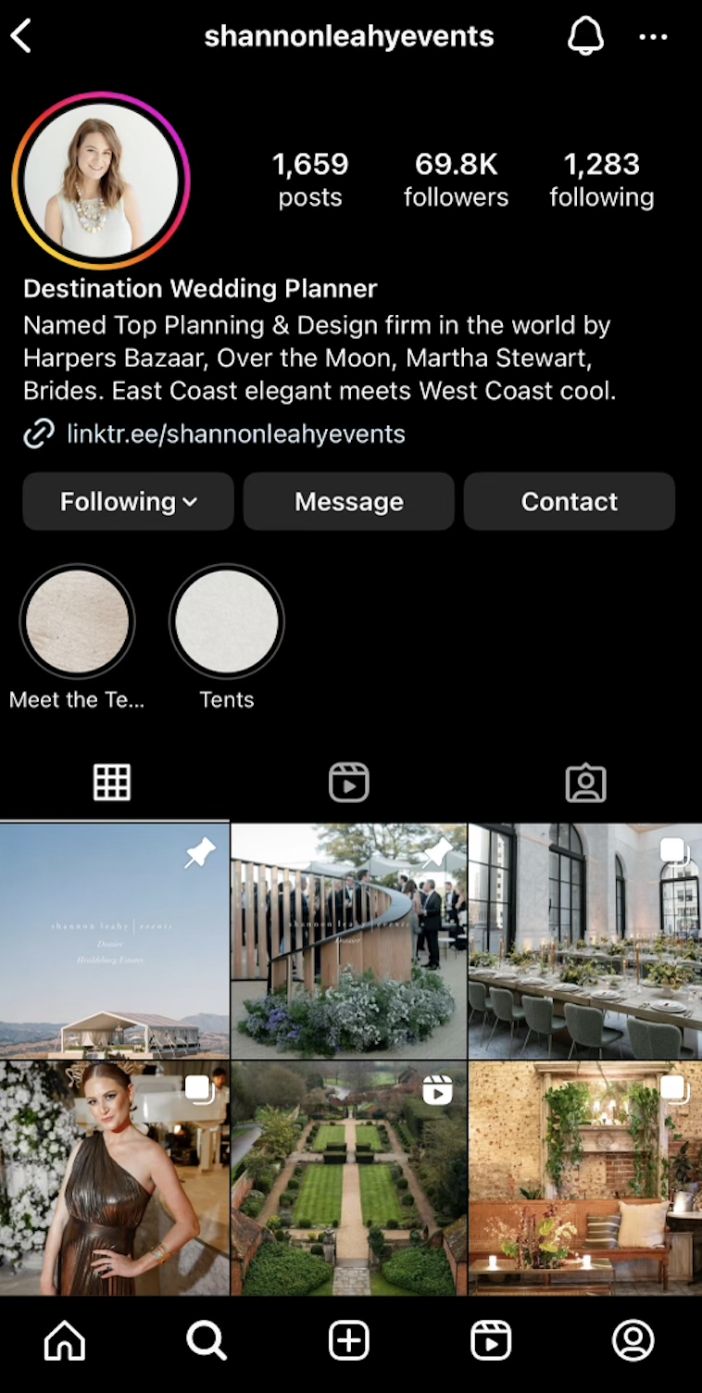
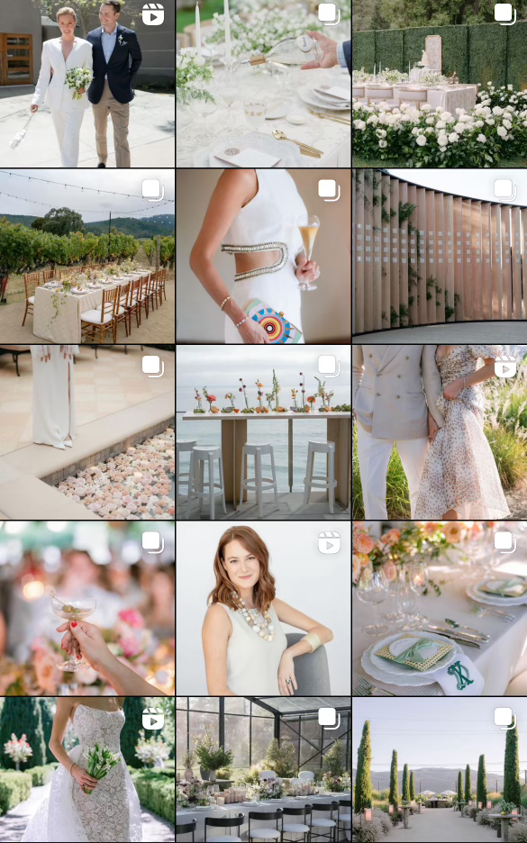
Influencer Campaign
Reach: Shannon Leahy has a strong online presence, including her Instagram account that showcases her curated wedding events. Her account boasts 69.8K followers, a testament to her proven ability to generate awareness and engagement as a tool to reach her target audience. Shannon's consistent delivery of meaningful content fosters organic engagement and bolsters SEO strategies through social signals, enhancing visibility, traffic, optimization, and brand awareness through scheduled posting. She adequately uses hashtags, tagging, and geo-tagging to leverage her account to users that are looking for inspiration. Given consumers' considerable trust in peer recommendations and significant engagement in the wedding sphere, Shannon emerges as an ideal affinity influencer and resource for bridal attire.
Engagement: Beyond her immense following, Shannon Leahy's influence is observable through her Instagram metrics. With an engagement rate of 0.85%, coupled with an average of 578 likes and 27 comments per post, her content resonates deeply within the wedding and event-planning community. Furthermore, her frequent posting regimen solidifies her algorithmic credibility and nurtures a distinct online persona. Leveraging her 69.8K follower base and the industry standard rate of $10 per 1000 followers per branded post, a $698 campaign would yield an exceptional return on investment.
Aesthetic: Shannon Leahy's hallmark aesthetic revolves around crafting visually appealing and innovative weddings characterized by understated luxury. Utilizing a blend of vibrant yet muted color palettes, natural backdrops, and stunning floral arrangements, her style is contemporary elegance. This distinctive visual language captivates followers and provides inspiration for those seeking guidance in wedding and event planning. She meticulously leverages videos, uses stories to showcase user generated content, and showcases her offerings to demonstrate best social media practices. Her posts are sources for stories, content curation, formats, and style benefits.
@shannonleahyevent's Instagram aesthetic
Group 01 – Part 2

Slide 16
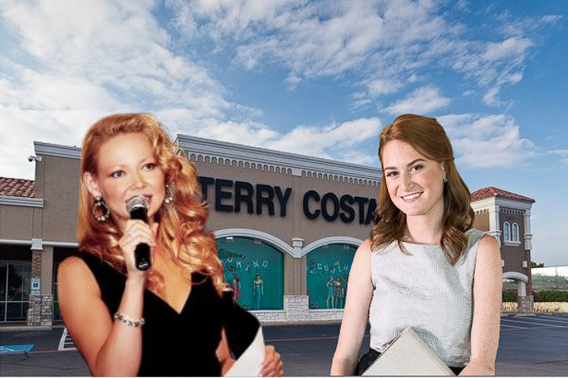
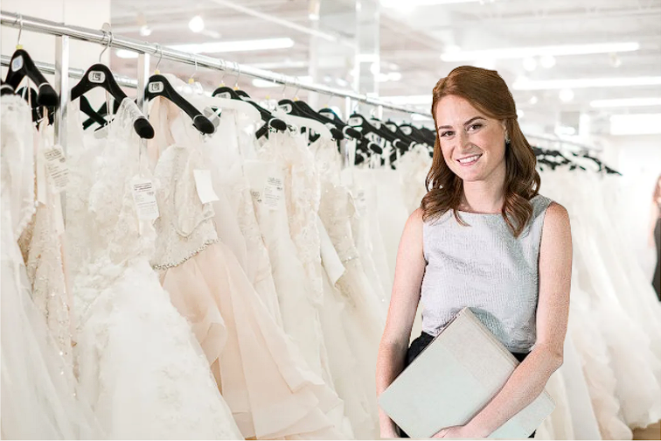
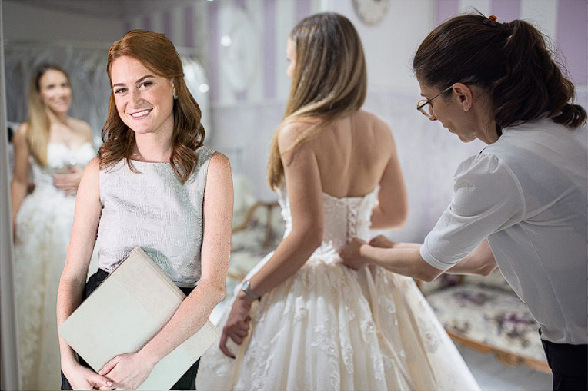
Storyboard
Video Concept: Terry Costa and Shannon Leahy Events make a collaborative video where a bride chooses a Terry Costa wedding dress and Shannon Leahy designs a wedding venue in Texas for the bride. Terry Costa bridal dress is shown on the video and modeled in Shannon Leahy’s designed wedding venue.
Platform: Instagram/Instagram Reels
Start Date: January 10th
End Date: May 20th
1
2
3
Terry Costa representative meets with Shannon Leahy in front of Terry Costa bridal store.
Song “This Will Be (An Everlasting Love)” by Natalie Cole plays.
Shannon Leahy takes a tour of the Terry Costa bridal department and camera pans to show the wedding dress selection.
Shannon Leahy brings in bride to try on wedding dresses inside Terry Costa’s bridal salon.
Group 01 – Part 2

Slide 17
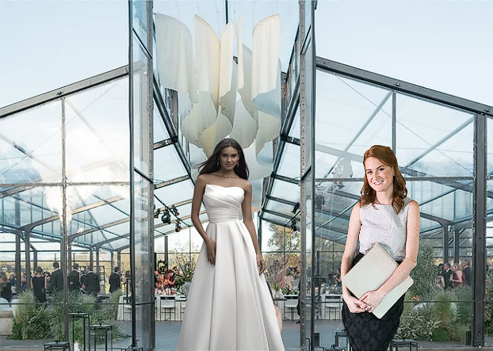
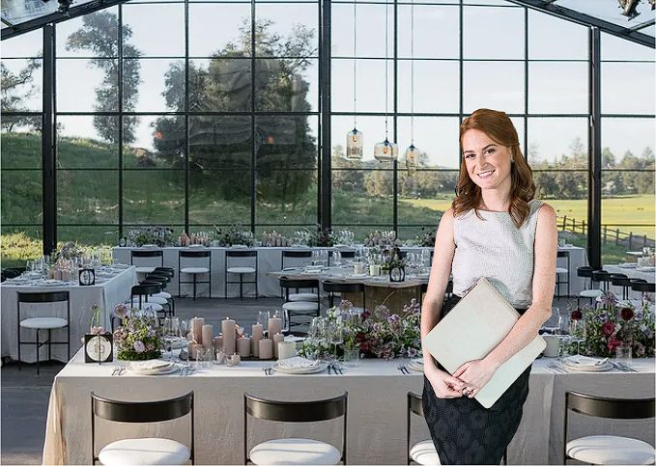
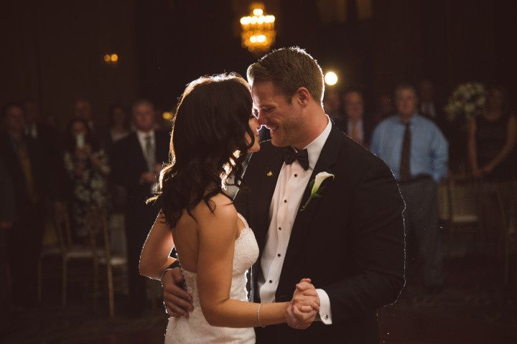
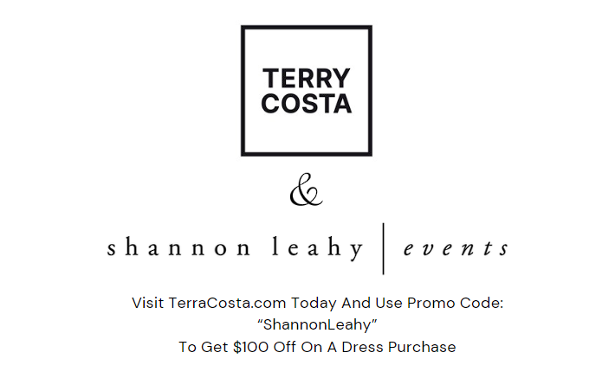
4
5
6
Transition with bride in Terry Costa dress in front of Shannon Leahy’s designed wedding venue.
Camera shows beautiful shots of Shannon Leahy’s designed wedding venue.
Newly wed bride wearing Terry Costa dress dances with husband into the night in Shannon Leahy’s designed wedding venue.
7
Video ends showing Terry Costa’s and Shannon Leahy’s logos with promotional text: “Visit TerraCosta.com Today And Use Promo Code: “ShannonLeahy” To Get $100 Off On A Dress Purchase”.
Group 01 – Part 2

Slide 18
Influencer Campaign
To amplify the video on the other 2 platforms (TikTok and Pinterest):
Repost the influencer's video to the Terry Costa accounts on the other 2 platforms.
Include relevant, popular tags such as:
To drive users to Terry Costa's owned content, the link in the video description will direct to the Terry Costa website landing page.
Preference is website (owned content) over selling on a social media shop
Keyword Tags | Avg. Monthly Searches *
Wedding Dresses | (100K – 1M)
Bridal shops near me | (100K – 1M)
Bridal dresses | (10K – 100K)
Bridal dresses near me | (10K – 100K)
Bridal shops | (10K – 100K)
Bridal gowns | (10K – 100K)
Wedding gowns | (10K – 100K)
Elegant bridal dresses | (10K – 100K)
*Source: Google Ads Keyword Planner
Group 01 – Part 2

Slide 19
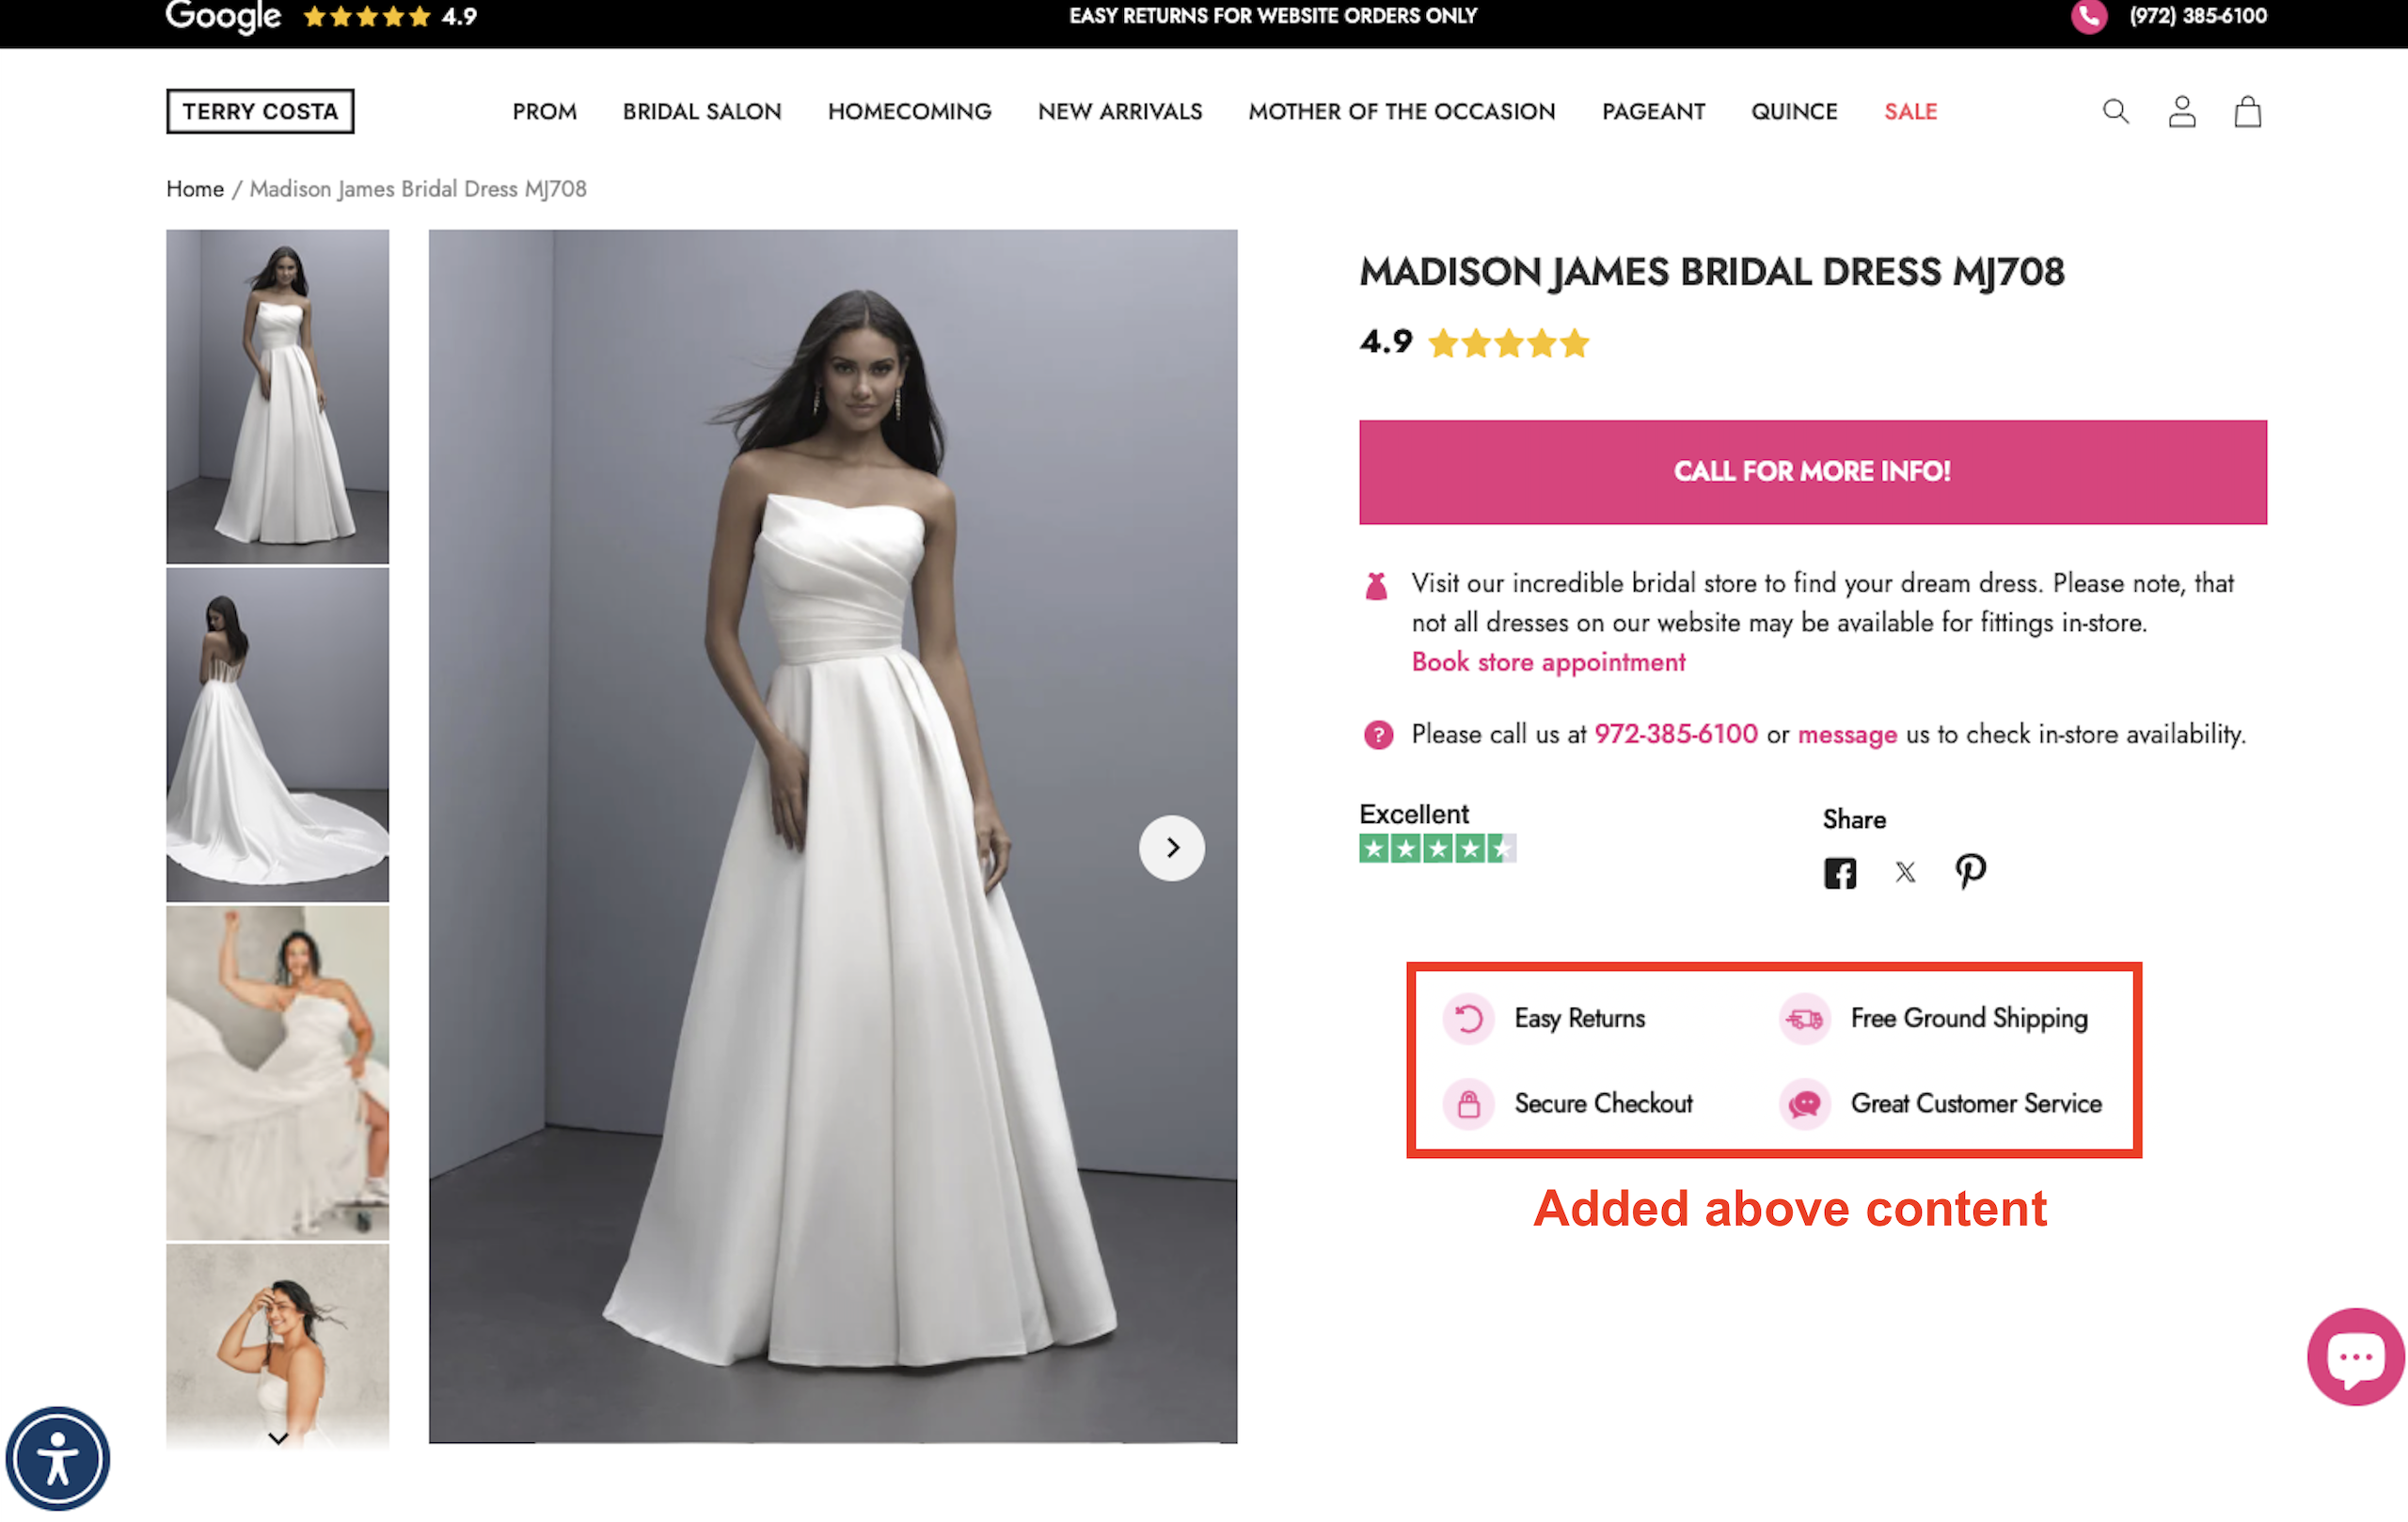
Landing Page
Group 01 – Part 2

Slide 20
Campaign Success Metrics
A budget of $10,000 will be allocated to incentivize user engagement and to help make the campaign "pop"
Video ad caption will encourage users to share and tag friends – each share/tag constitutes one entry to win $2,000 towards the wedding of their dreams! 5 winners to be chosen in a random drawing.
This will encourage users to promote the post for greater awareness. Since awareness alone will not generate conversions...
...ROI and campaign success will be tracked using a unique promo code
Influencer provides a unique promo code in the video for $100 off a dress purchase. This creates a call to action and will help drive conversions.
ROI measured by dresses purchased using the unique promo code.
Provides the ability to track customers that were referred by the video ad.
Group 01 – Part 2

